Slide 1

MAPMaN: Multi-Stage U-Shaped Adaptive Pattern Matching Network for Semantic Segmentation of Remote Sensing Images
Tingfeng Hong¹, Xiaowen Ma¹, Xinyu Wang¹, Rui Che¹, Chenlu Hu¹, Tian Feng¹, Wei Zhang^{1,2}
¹School of Software Technology, Zhejiang University, Hangzhou, China
²Innovation Center of Yangtze River Delta, Zhejiang University, Jiaxing, China
Notes:
Ladies and gentlemen, esteemed professors, distinguished scholars, good morning. It’s a great pleasure to be here today to present our work entitled “MAPMaN: Multi-Stage U-Shaped Adaptive Pattern Matching Network for Semantic Segmentation of Remote Sensing Images”. Our team is from Zhejiang University, and I am Tingfeng Hong.

Slide 2
INTRODUCTION

Slide 3
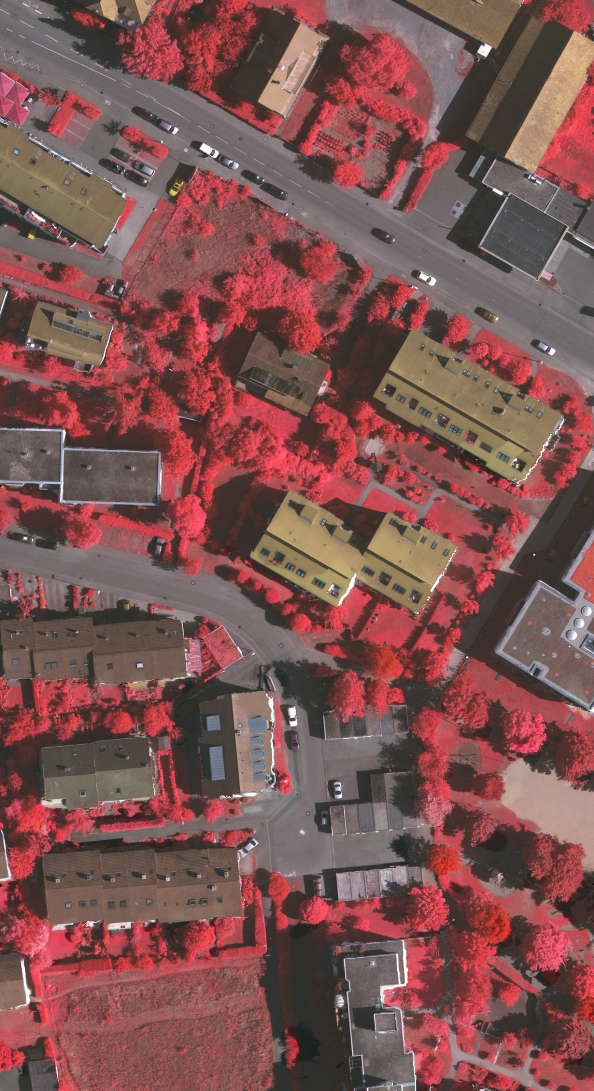
INTRODUCTION
INTRODUCTION
Segmentation of RSIs
Assign a label to each pixel
Land use classification
Agricultural production estimation
Environmental monitoring
Notes:
As a pixel-wise classification problem, semantic segmentation is a fundamental task in the field of computer vision, and significantly contributes to the analysis of remote sensing images and relevant applications.

Slide 4
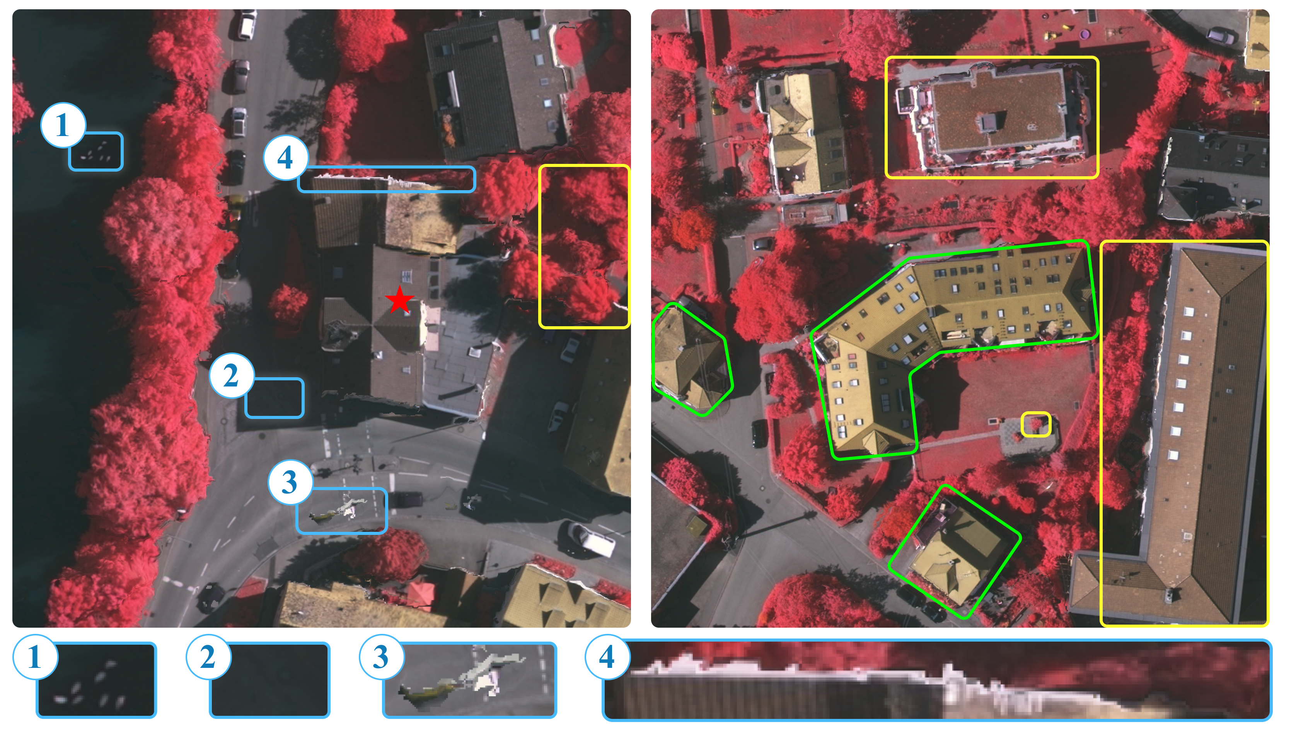
INTRODUCTION
INTRODUCTION
Challenges
With significant background noise (blue boxes)
Exhibit extensive multiscale phenomena (yellow boxes)
Objects in same pattern with complex compositional relationships and geometric variations (green boxes)
Notes:
Compared to natural images, RSIs present several notable challenges. Firstly, RSIs often possess obvious background noise, such as shadows, blurred edges, and ambiguous background. Additionally, RSIs tend to exhibit a multi-scale phenomenon. Both inter-class and intra-class ground objects have significant scale variations. Moreover, ground objects in RSIs often exhibit specific spatial distribution patterns. For example, buildings are typically individually placed, while cars, roads, and houses may represent a neighborhood. Even within the same pattern, ground objects can exhibit complex compositional relationships and geometric variations, such as buildings with different orientations and shape.

Slide 5
MOTIVATION

Slide 6
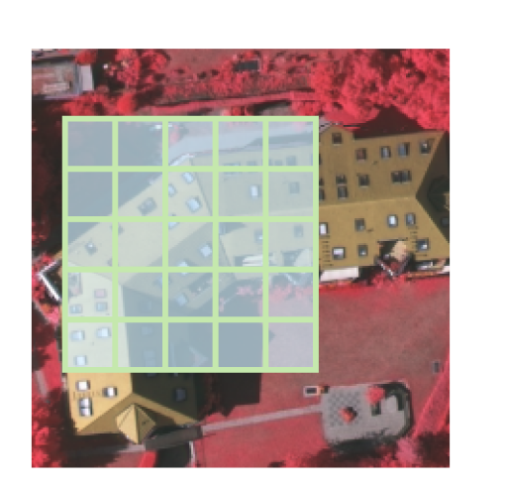
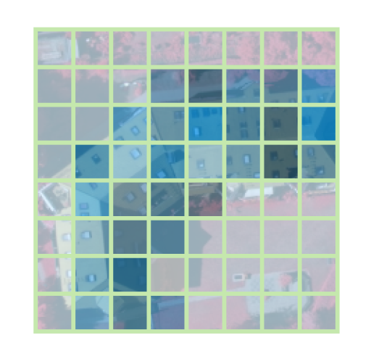
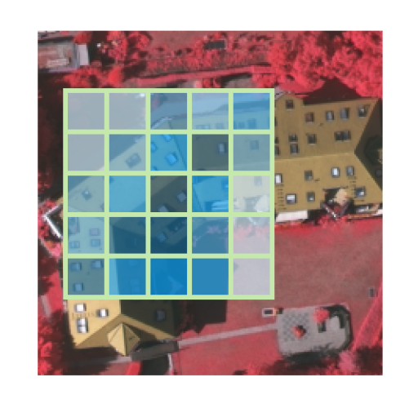
MOTIVATION
Shortcomings of past methods
Convolution
Fixed weights
Fixed shapes
Global Attention
Background noises
Quadratic time complexity
Local Attention
Short-range modeling
Fixed shapes
Notes:
However, existing methods have certain limitations and cannot fully address the aforementioned challenges. Specifically, in semantic segmentation, the commonly used convolutional kernels are essentially fixed filters. As it (1) The fixed weights cause suboptimal performance for modeling compositional relationships; (2) the fixed shapes lead to unsatisfactory adaptability to geometric variations. Recently, deformable convolutions have been proposed to address the issue on geometric variations. However, they are yet to consider the compositional relationships.
Recent studies have exploited the attention mechanism to establish Vision Transformers. However, it introduces excessive background noises and has a quadratic time complexity due to dense matrix multiplications. Although local attention and sparse attention have attempted to resolve these issues, their capabilities to capture long-range dependence and adapt to geometric variations can be negatively impacted.

Slide 7
MOTIVATION
Composition of ViTs
MLP-mixer
Replacing attention with MLP
ConvNeXt
Gradually transforming the standard ResNet into the design of ViTs
DWNet
Key to localized attention is sparse connectivity and weight sharing
Conv2former
Replacing attention with convolutional modulation
Notes:
Most recently, there has been a growing number of research exploring the composition of Vision Transformers. Several studies attempt to replace the token mixers represented by the attention mechanism with MLP or its variants, such as MLP-mixer. These replacements achieve competitive performance, which, however, have raised the question on the key to impacting the performance of ViTs. ConvNeXt gradually transforms the standard ResNet into the design of ViTs, which discovers several critical components in ViTs. DWNet observes the similarities between depth-wise convolution and local attention regarding sparse connectivity and weight sharing, and replaces the local attention in Swim Transformer with the dynamic depth-wise convolution. Conv2Former calculates adaptive weights with large-kernel depth-wise convolutions. They all exhibits performance comparable to ViTs.
These studies, focusing on the sources of model performance, have inspired us to look into attention and come up with our own method for long-range adaptive weight aggregation.

Slide 8
METHOD

Slide 9
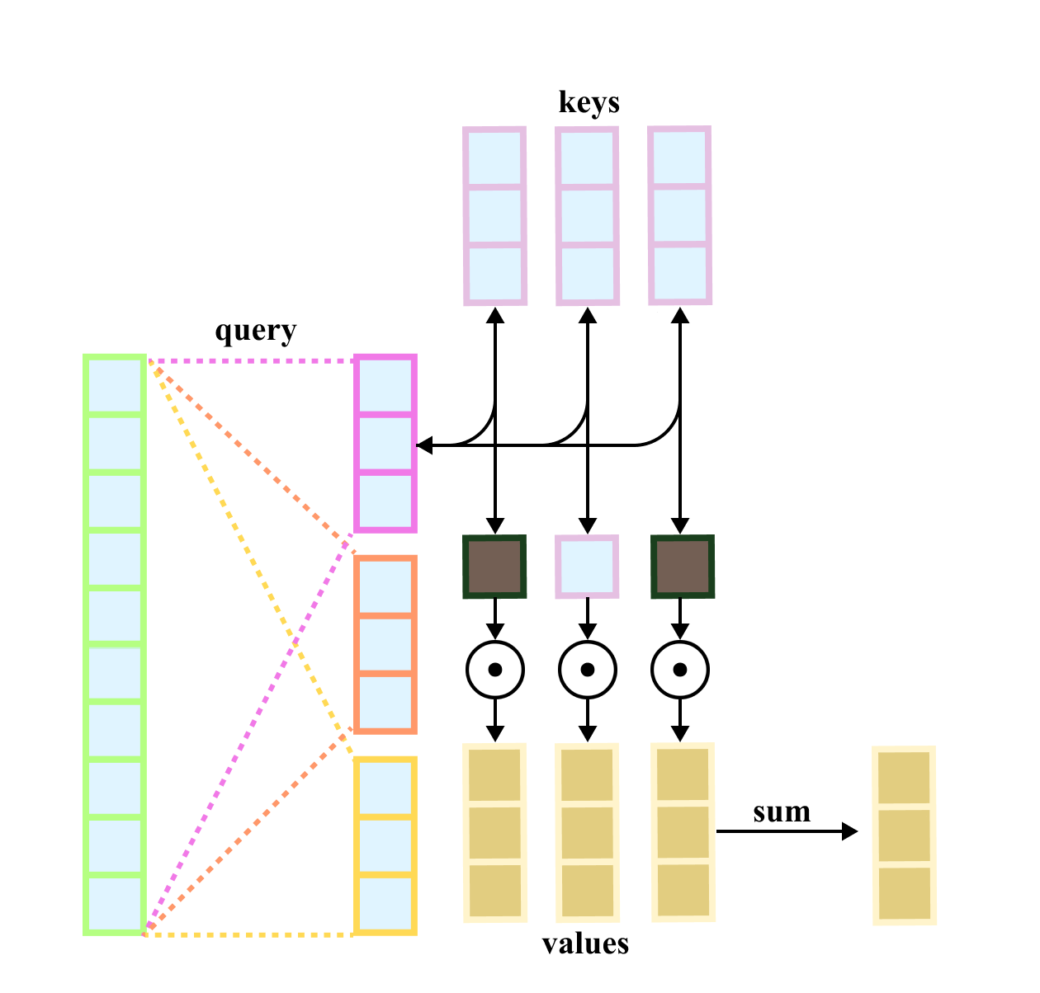
METHOD
The Key of Attention
Each head focuses on different aspects of the inputs, capturing different patterns of relationships.
Weights are assigned based on the correlation between the inputs to identify the spatial distribution.
Notes:
Now, let’s examine the design of the MHSA module. The term “multi-head” suggests that the input feature is mapped to h different feature spaces using h different sets of mappings. This allows each head to capture distinct patterns of relationships. “Self-attention” means that the queries, keys, and values are all derived from the same input. This enables the input sequences to interact with one another, and the module assigns weights to different elements based on their correlations. By doing so, the module can efficiently process various spatial distributions and capture long-range dependencies within the input.

Slide 10
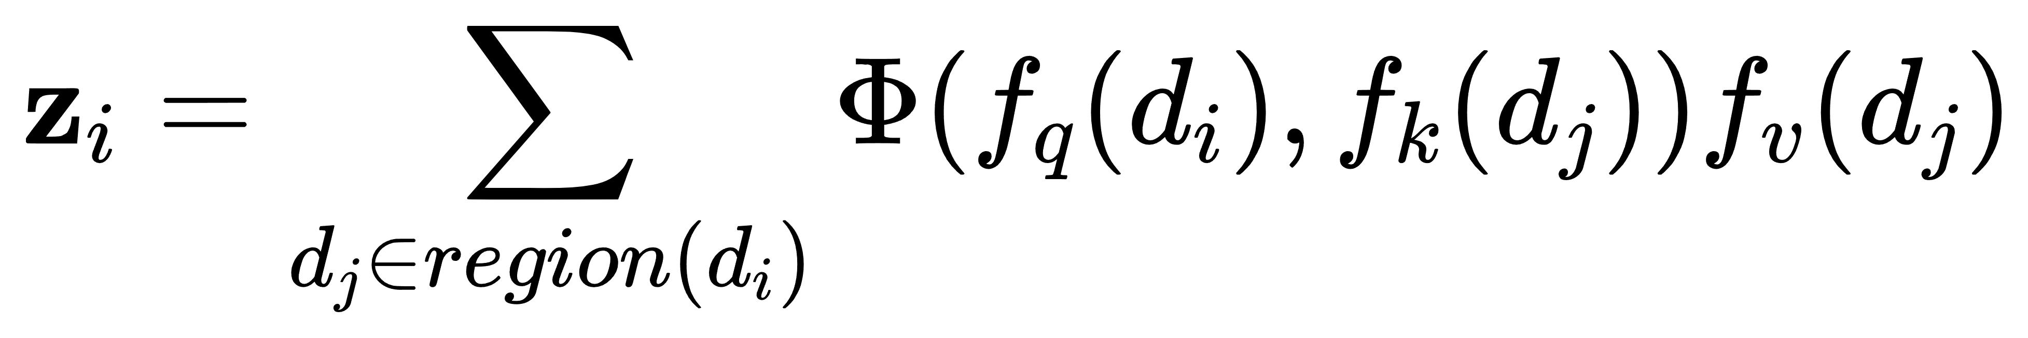
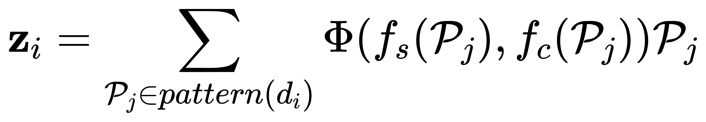
METHOD
The Key of Attention
MHSA
Adaptive Pattern Matching (ours)
Notes:
We can abstract the MHSA module into this formula: $region\left(d_{i}\right)$ denotes the entire feature map in the global attention or specific pixels in sparse attention, $Φ$ represents the dot product operation, and $f_{q}$, $f_{k}$, and $f_{v}$ refer to feature mappings. Our Adaptive Pattern Matching (APM), consisting of Adaptive Pattern Sampling (APS) and Adaptive Feature Modulation (AFM), enhances the above formulation as follows.

Slide 11
METHOD
Adaptive Pattern Matching
APS: Searches for a group of pixels belonging to the same spatial distribution pattern of ground objects for each pixel.
AFM: performs point-wise convolutions on the group of pixels along the spatial and channel dimensions to recognize the compositional relationships
MHSA
Adaptive Pattern Matching (ours)
Notes:
Specifically, the APS searches for a set of pixels $𝓟=pattern\left(d_{i}\right)$ belonging to the same spatial distribution pattern for each pixel, which can identify geometric variations and ignore background noises; the AFM includes two simple but effective methods to calculate adaptive weights $Φ\left(f_{s}\left(𝓟_{𝓳}\right),f_{c}\left(𝓟_{𝓳}\right)\right)$ regarding spatial and channel dimensions, so as to identify the compositional relationships of the pattern pixels.

Slide 12
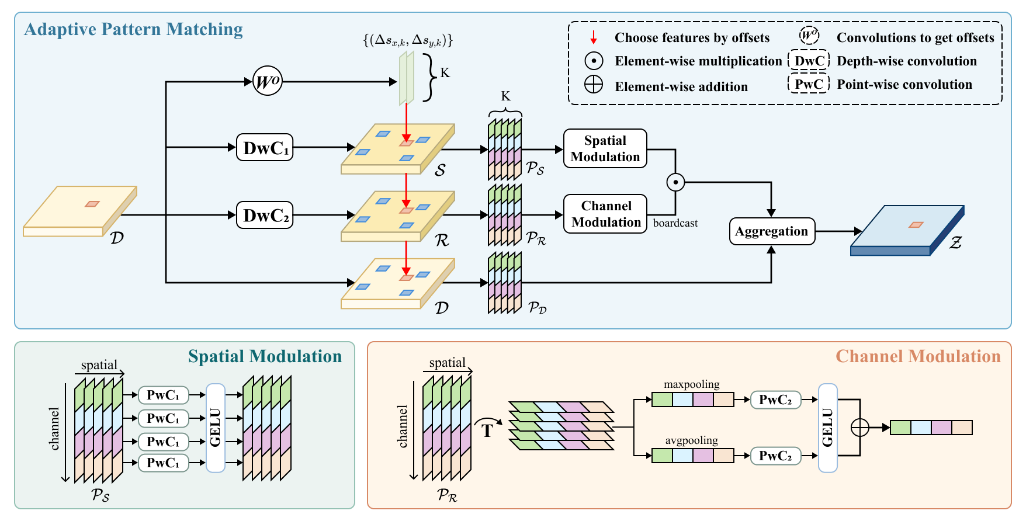
METHOD
Adaptive Pattern Match
APS: Searches for a group of pixels belonging to the same spatial distribution pattern of ground objects for each pixel.
AFM: performs point-wise convolutions on the group of pixels along the spatial and channel dimensions to recognize the compositional relationships
Notes:
As shown in the Figure, we first emulate the MHSA module by mapping the input feature map to different feature spaces. Then, for each pixel of the input, we use two consecutive convolutions to obtain 2K offset coordinates. The first convolution is a depth-wise convolution with a kernel size of 5, which is used to gather local information. The second convolution is a point-wise convolution, which is used to change the dimension. We use these 2K coordinates to select K pixel sequences, thus obtaining the pattern information to which the pixel belongs. Based on the pattern information obtained from APS, we use APM for weight aggregation. For $P_{S}$, adaptive weights are computed along the spatial dimension using Point-wise convolution based on the compositional relationship of the pattern pixels. It is noteworthy that the adaptive weights for each channel are calculated separately according to its own content, which allows each channel to focus on an unique compositional relationship. For $P_{R}$ , we first use average pooling and global pooling to obtain the contextual information，and then use Point-wise convolution along the channel dimension to decide which compositional relationship is more important. Finally, we employ the Hadamard product to get the adaptive weights for the pattern pixels, which are used to aggragate the pixels in $P_{D}$.

Slide 13
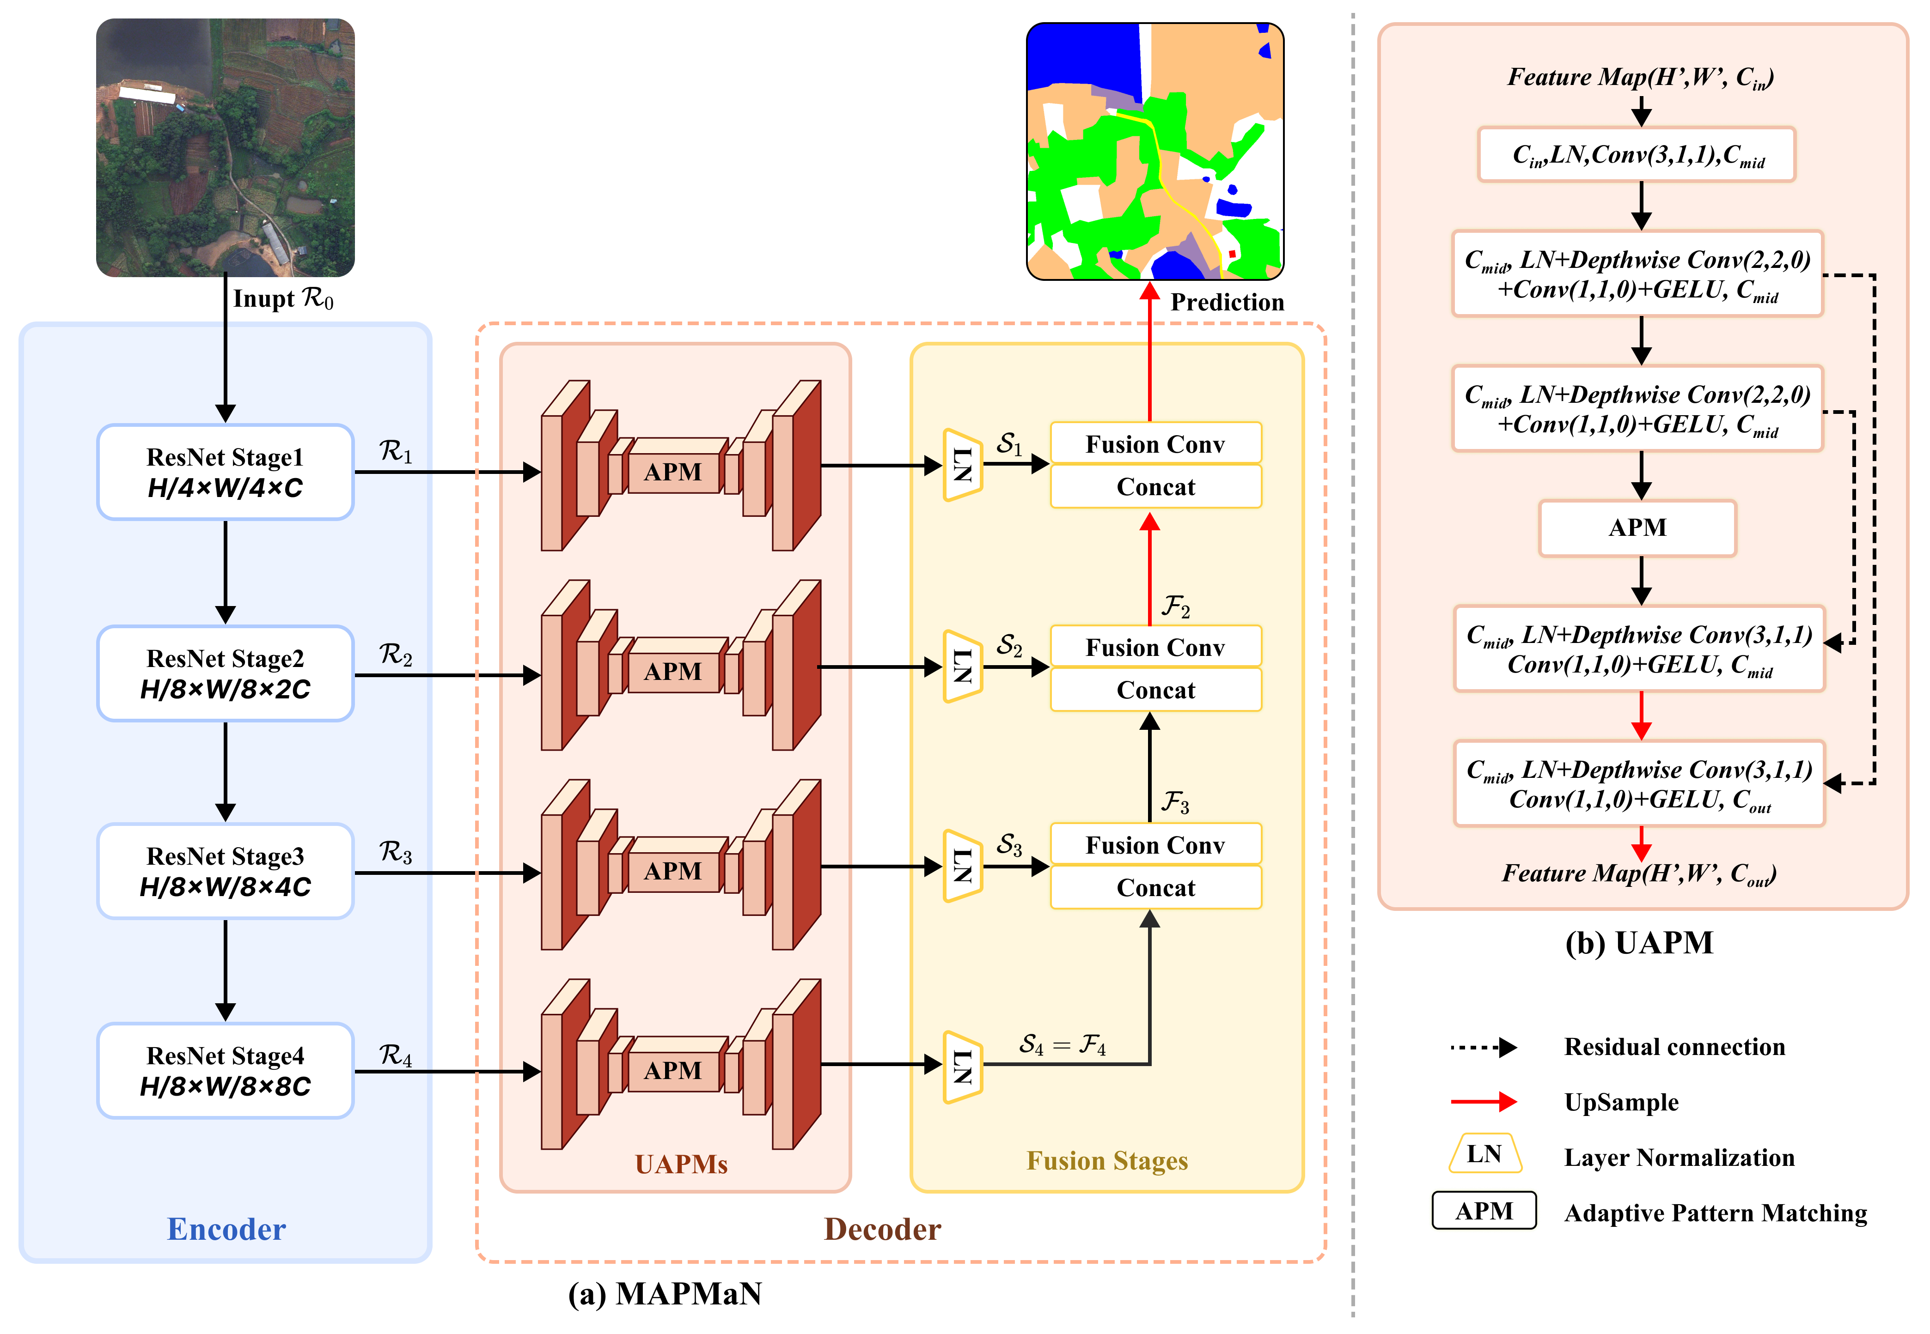
METHOD
Overall Architecture
Embedded in a tiny U-shaped network to:
Nested multiscale modeling;
Reducing computational complexity;
Increasing the receptive field;
Reusing the spatial information.
Notes:
To extract features at multiple scales, we incorporate the discussed APM as a module at the bottom level of our UAPM, a tiny U-shaped network. Moreover, it can also be integrated into an outer network to provide the following advantages:
It significantly reduces memory consumption required by the bottom-level feature enhancement.
It increases the receptive field, enabling the bottom-level module to effectively capture long-range dependencies.
It efficiently reuses spatial information of the feature maps through residual connections, enhancing the modeling of fine details.
What’s more, we devise MAPMaN, a Multi-Stage U-Shaped Adaptive Pattern Matching Network. Its encoder is based on ResNet50 with dilated convolutions, and the decoder comprises the UAPMs, layer normalization, and a sequence of fusion convolutions. The features from each stage are concatenated and passed through fusion convolutions in a bottom-up manner, getting the segmentation result in the initial stage.

Slide 14
EXPERIMENTS

Slide 15
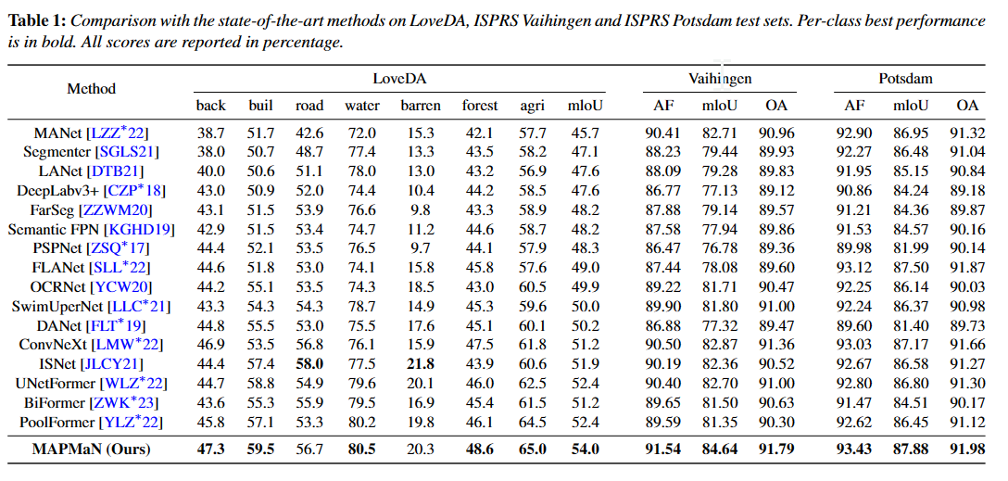
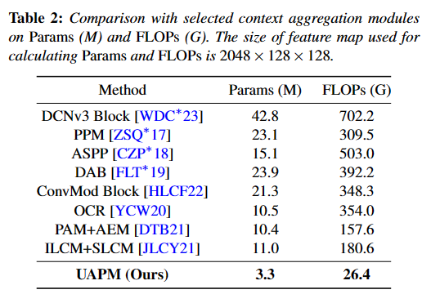
EXPERIMENT
Comparison with representative methods
Notes:
We conducted the experiments on three RSI datasets. Our MAPMaN had achieved state-of-the-art performance on all three datasets. Specifically, it outperformed the second-best model by 1.6% and 1.8% in terms of mIoU on the LoveDA and Vaihingen datasets, respectively.
In addition, we compare several context aggregation modules with our UAPM regarding the number of parameters and the number of floating-point operations per second. Because of only using depth-wise and point-wise convolutions, our UAPM requires significantly less Params and FLOPs compared to the regular methods. It is noteworthy that our UAPM requires only 31% of Params and 8% of FLOPs compared to the light-weight OCR module.

Slide 16
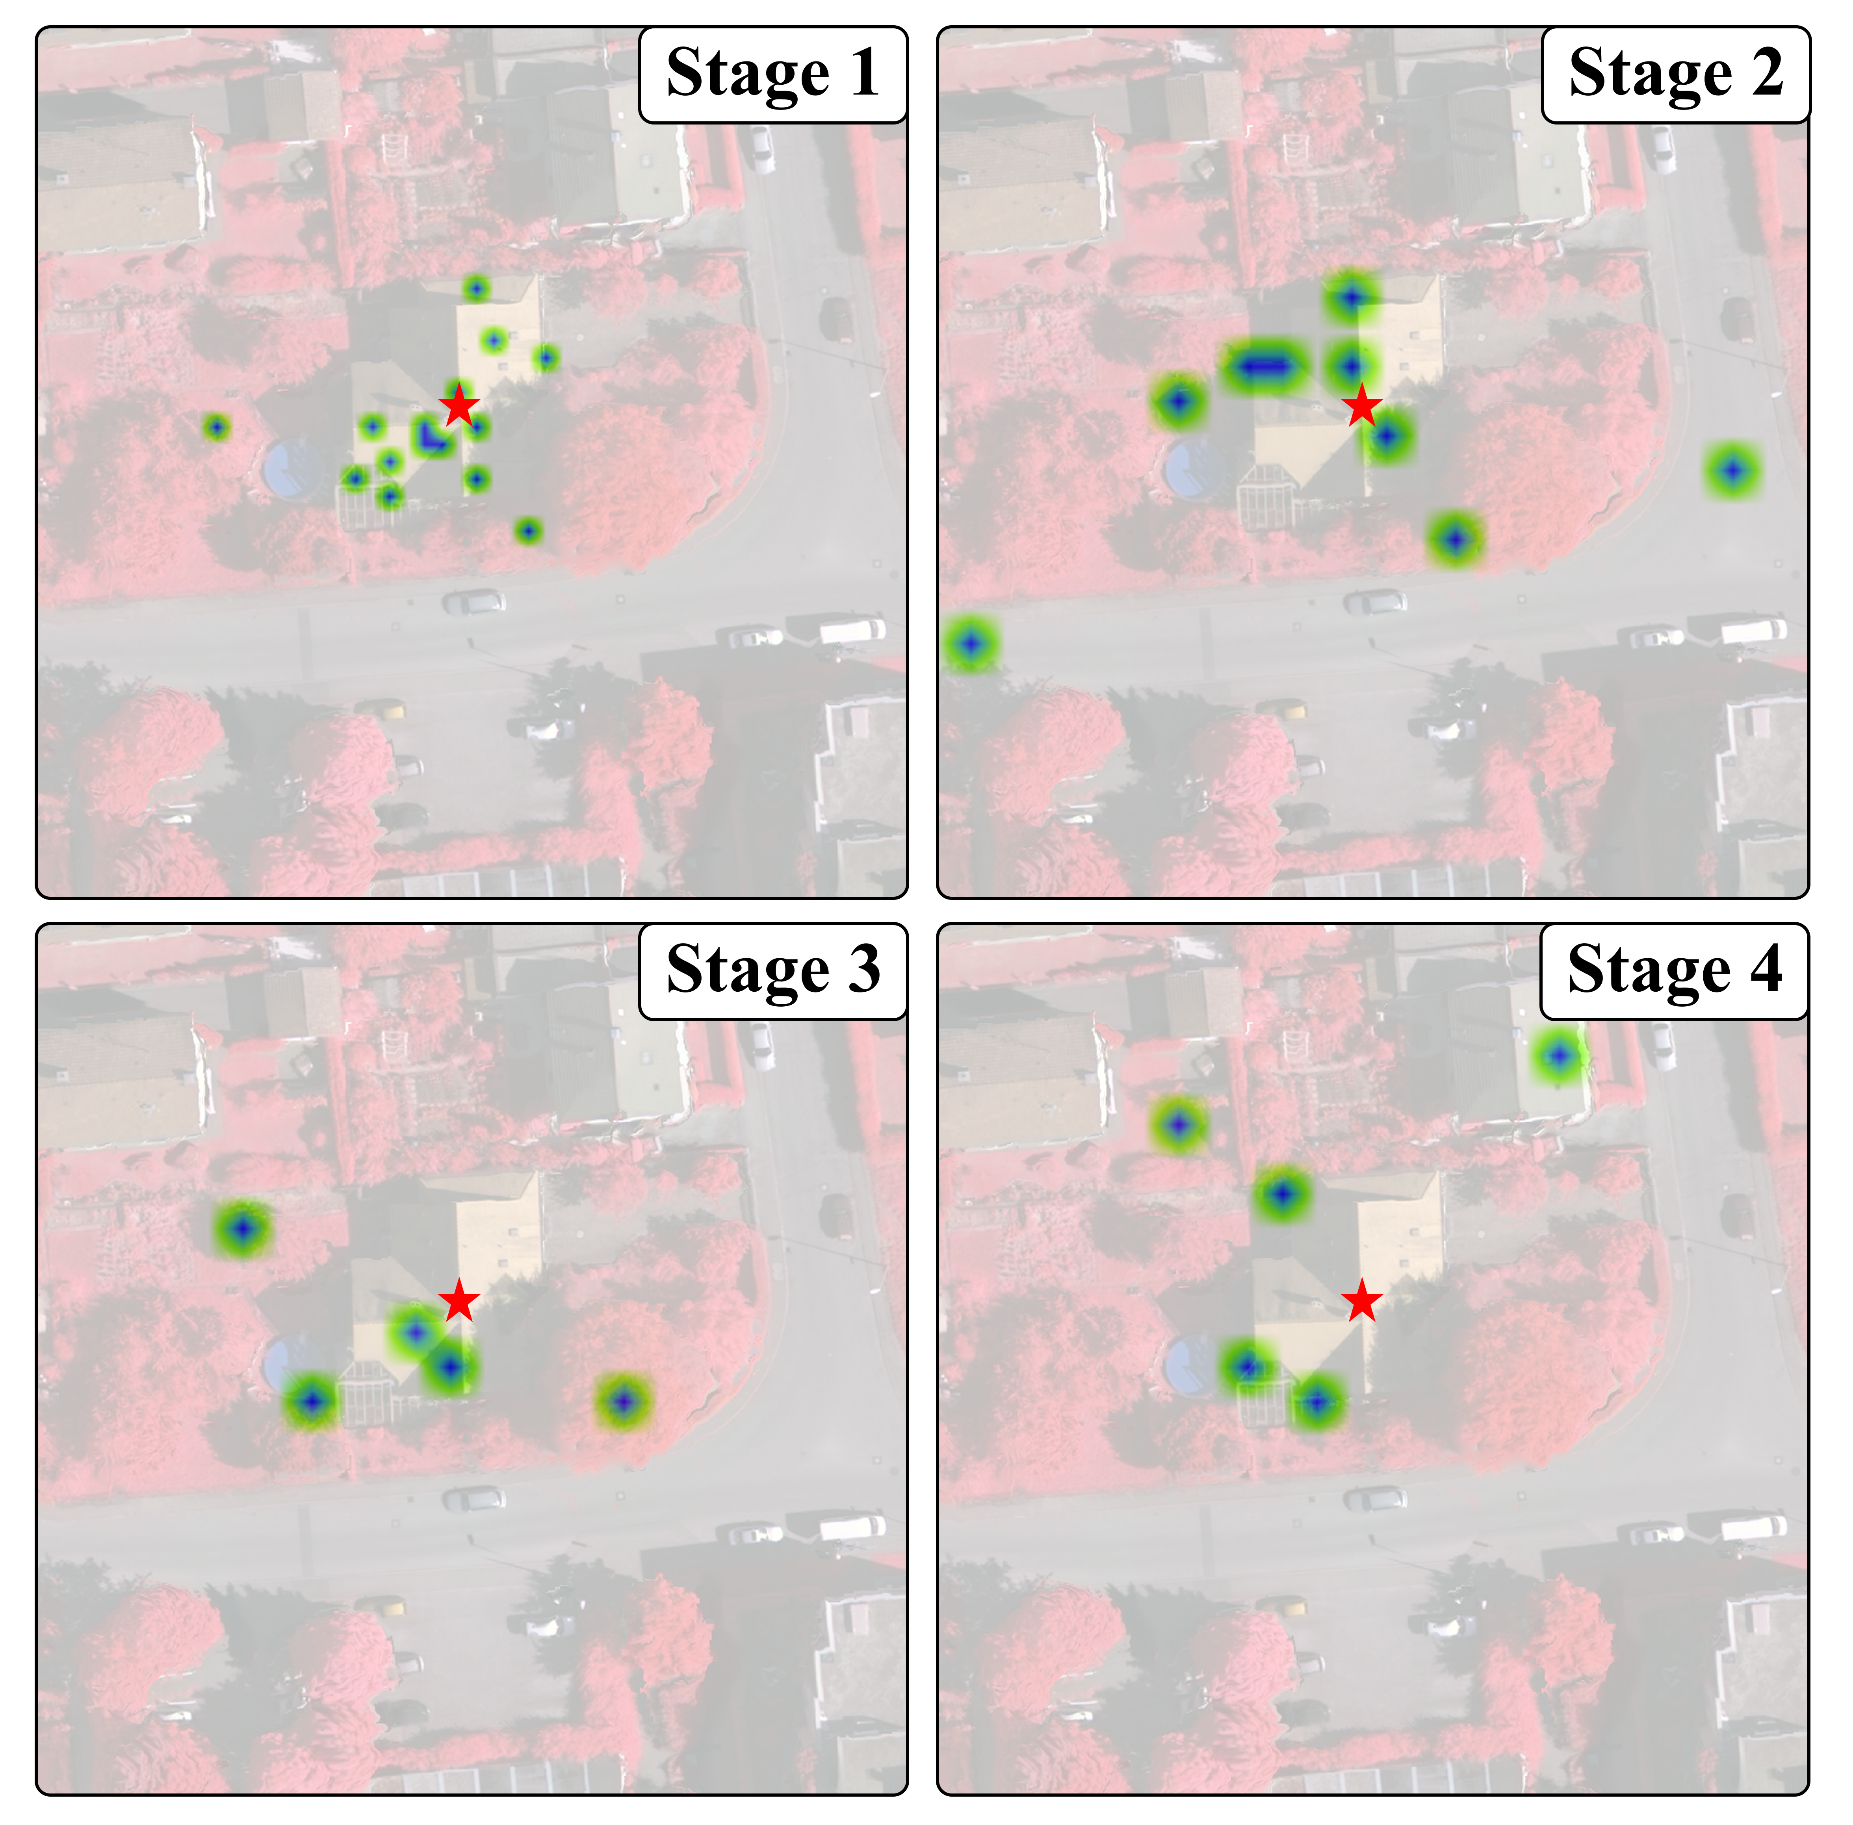
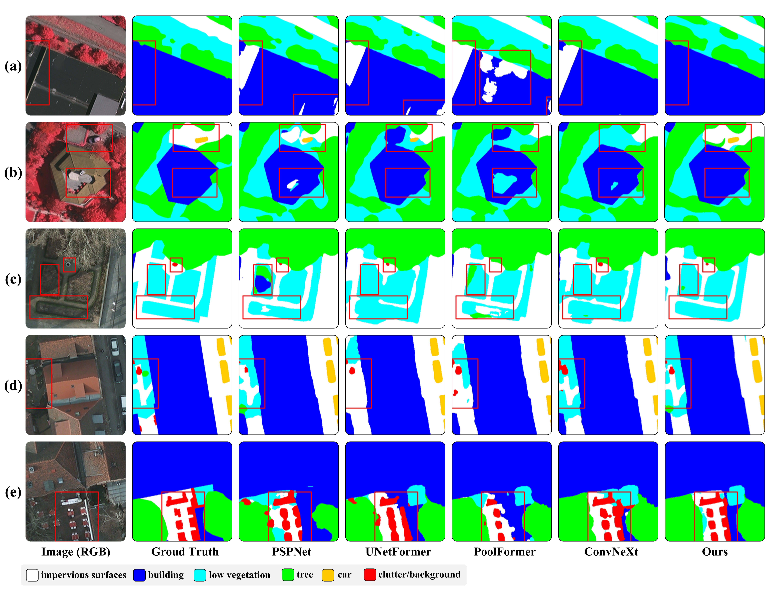
EXPERIMENT
Visual Comparison
Notes:
The left figure shows the visualization results from our MAPMaN and other methods. It is evident that MAPMaN excels in recognizing the overall structure and edges, even in the presence of complex backgrounds. It also exhibits remarkable proficiency in identifying the shapes of complex specific compositions, such as gardens comprising vegetation and trails. By incorporating UAPMs, MAPMaN showcases exceptional ability in capturing details of objects at various scales, especially those small-scale ones.
Additionally, we investigate the focus of the APM module at each stage. As shown in the right Figure, the APMs at shallower stages concentrate more on spatial details and patterns formed by individual ground objects, while the ones at deeper stages pay attention to broader scenes. Therefore, the stage-specific adaptability to different ground objects suggests the effectiveness of our APM and multi-scale modeling.

Slide 17
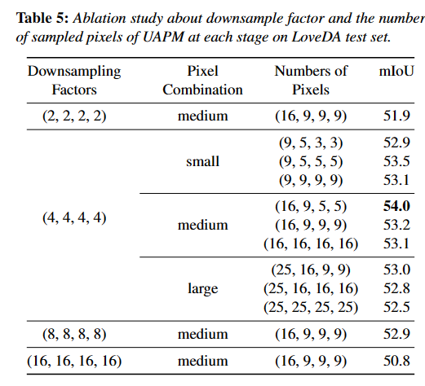
EXPERIMENT
Ablation study
Notes:
Our MAPMaN has two hyperparameters: the downsampling factor and the number of pixels per pattern of the UAPM module at each stage. This Table presents the results regarding hyperparameters on LoveDA dataset. It is observable that a downsampling factor of 4 enable the optimal mIoU, and other values lead to performance degradation. Regarding the numbers of pixels, we find that excessive pixels in deeper stages can result in decreased performance, while shallower stages require more pixels. Therefore, we select the downsampling factors to 4 and the numbers of pixels to (16, 9, 5, 5) as the optimal values.

Slide 18
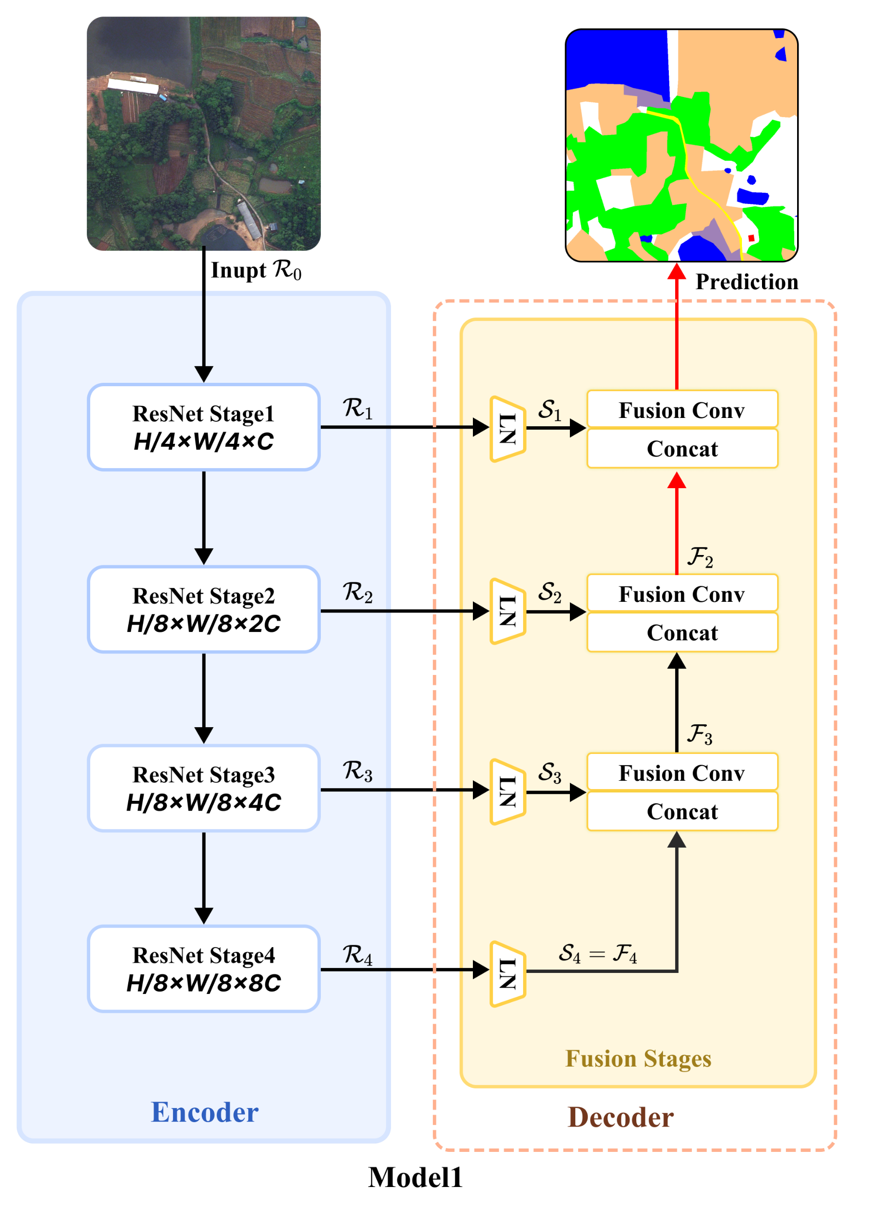
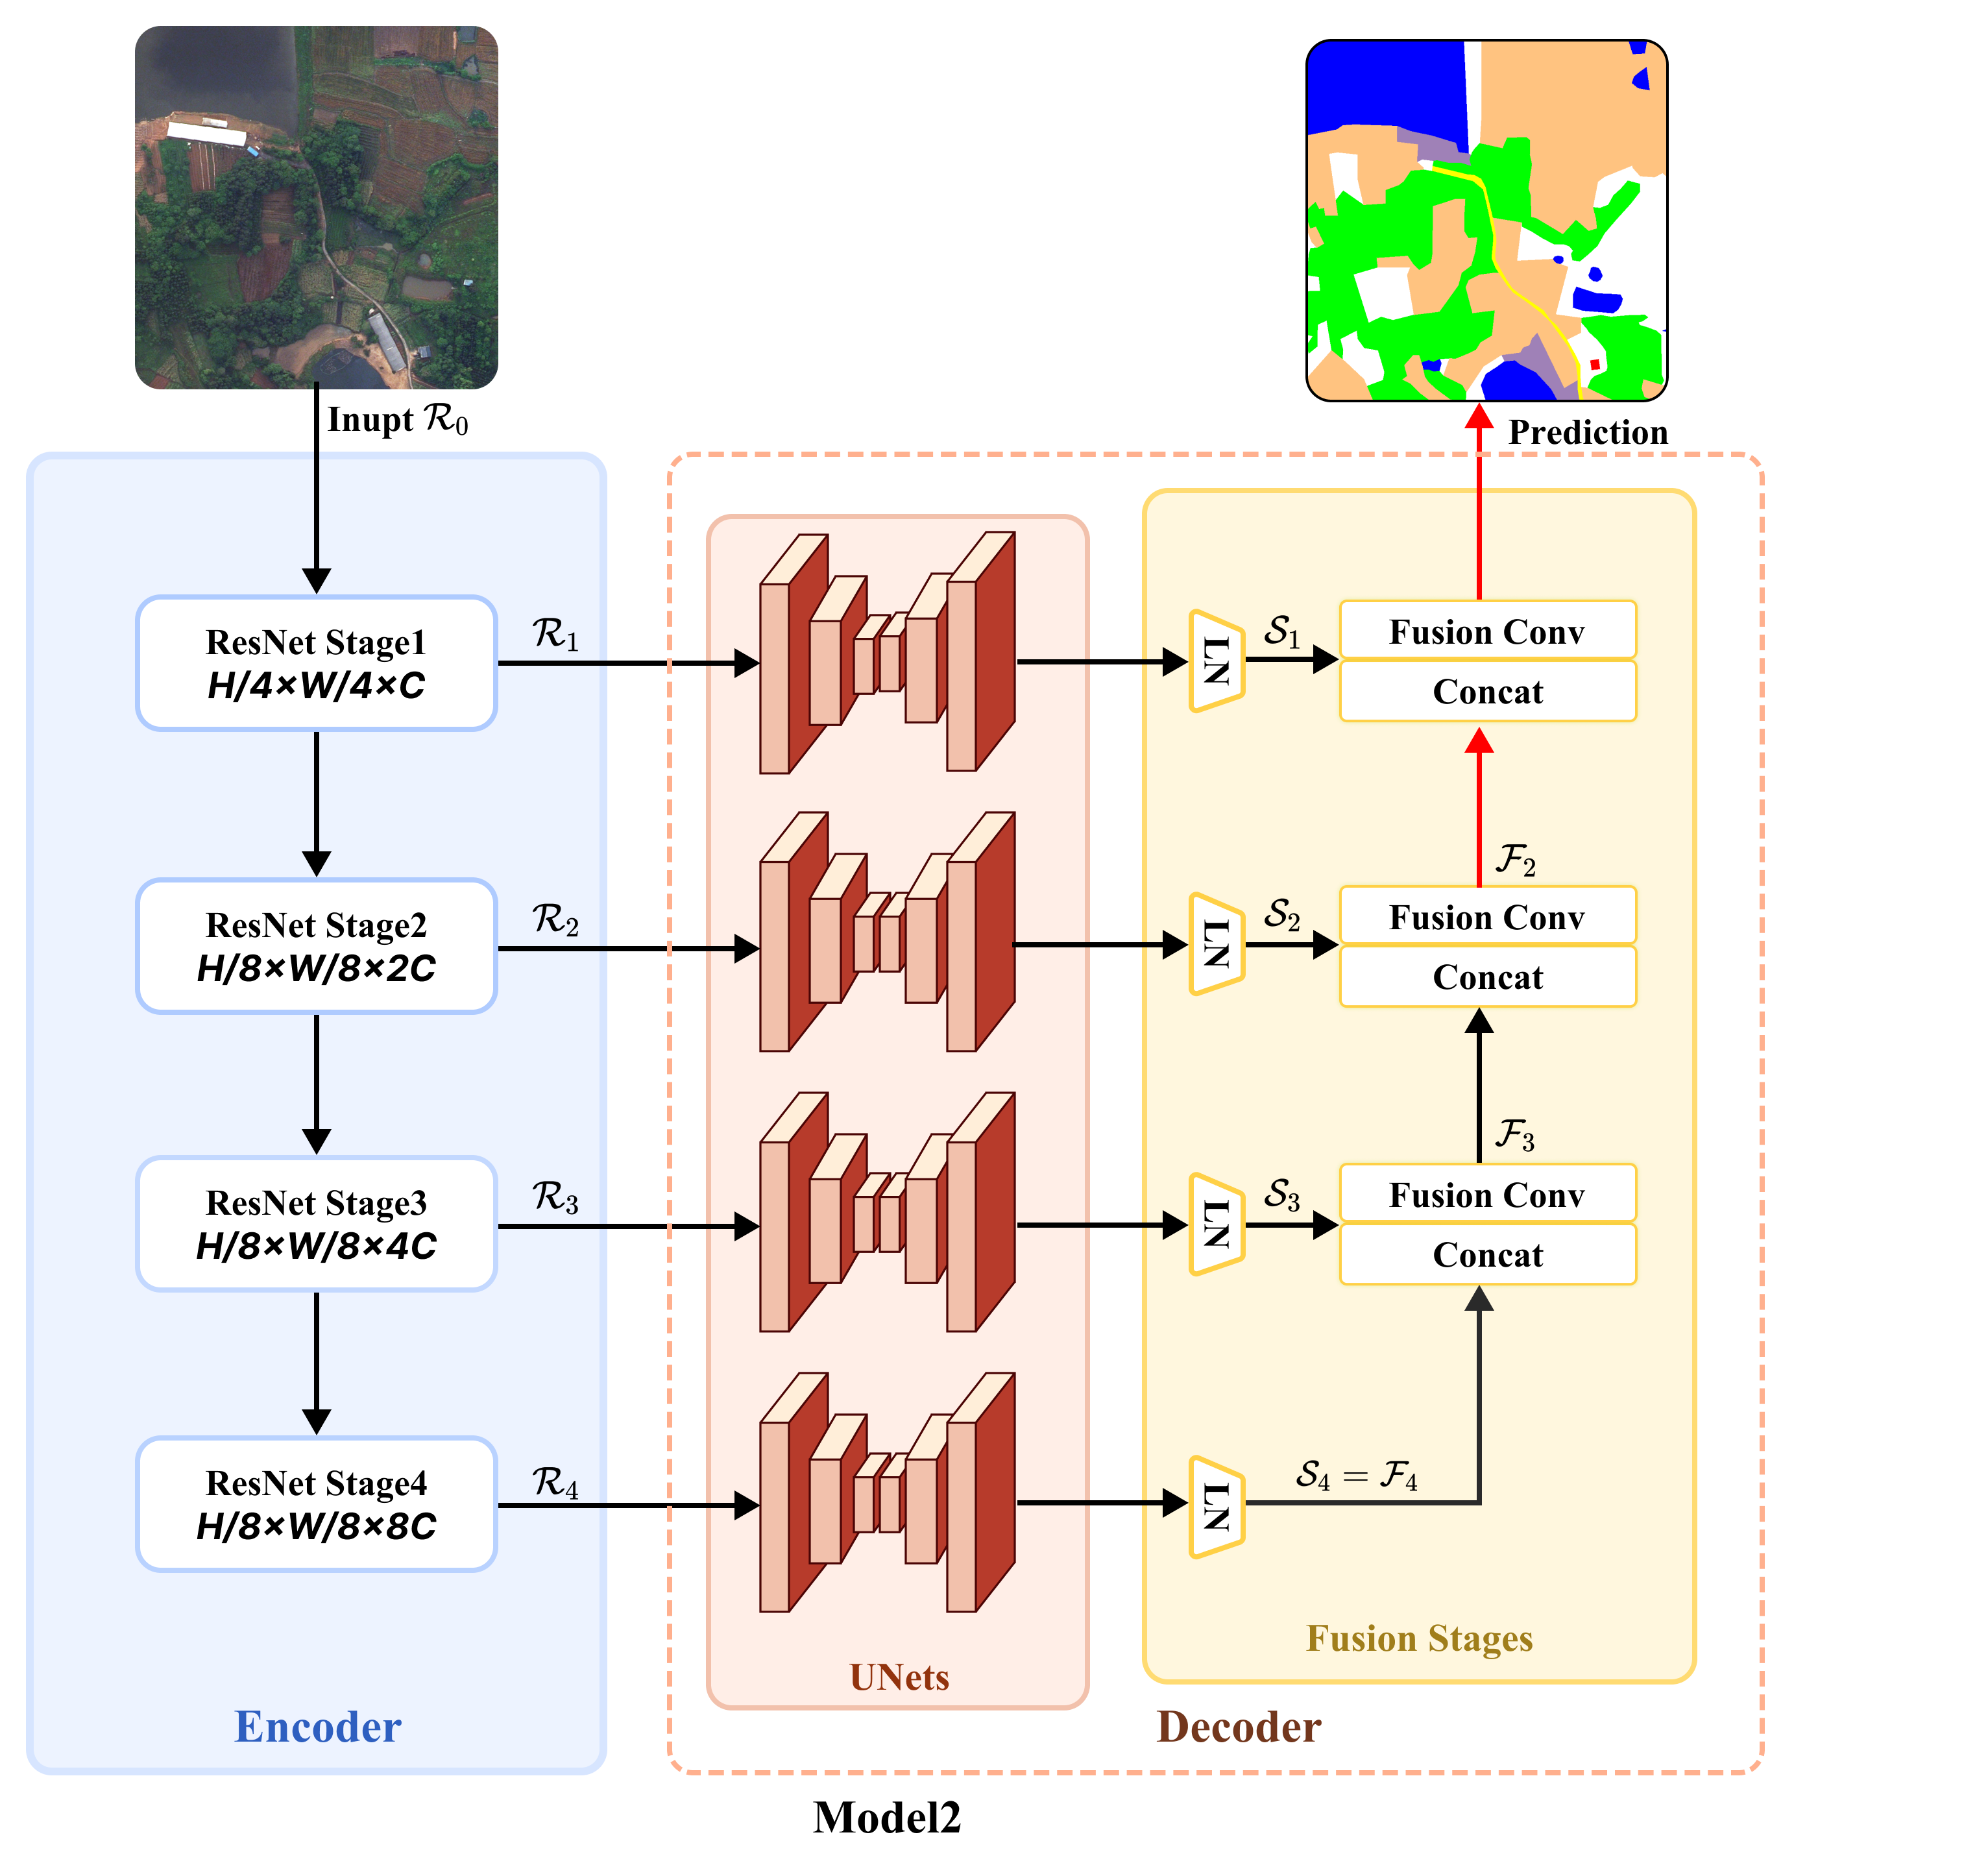
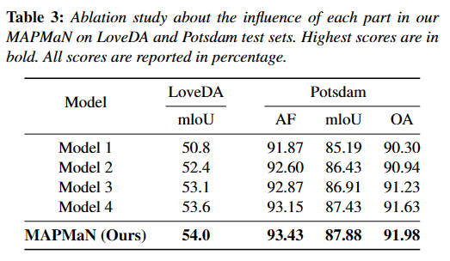
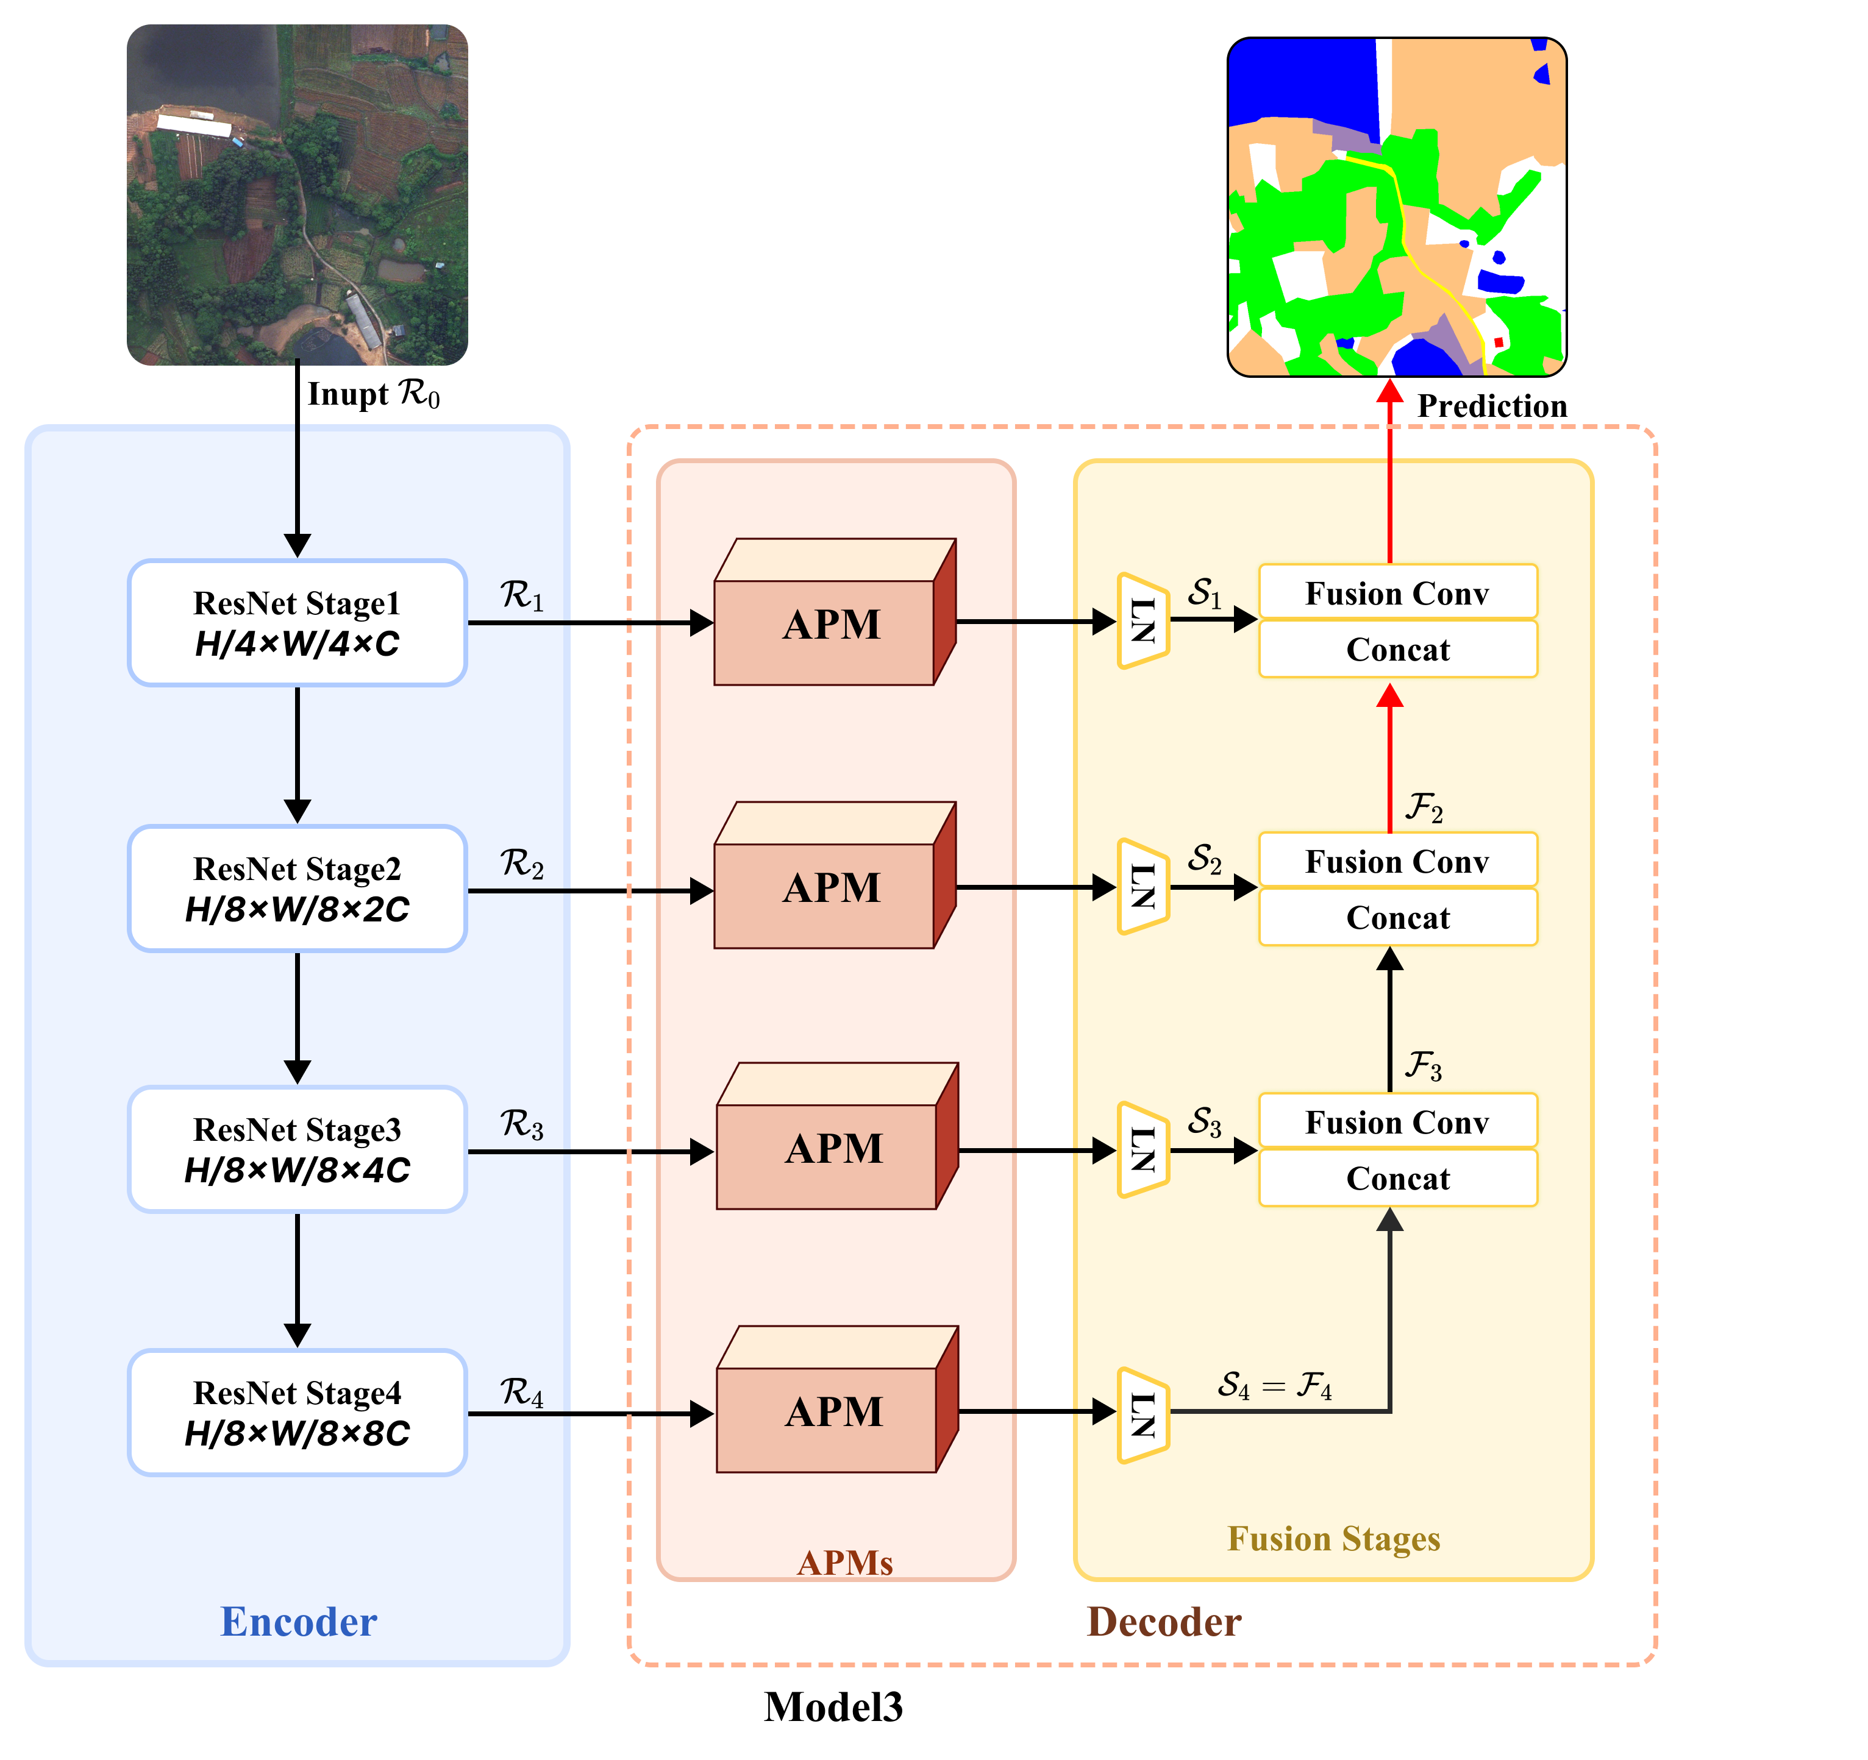
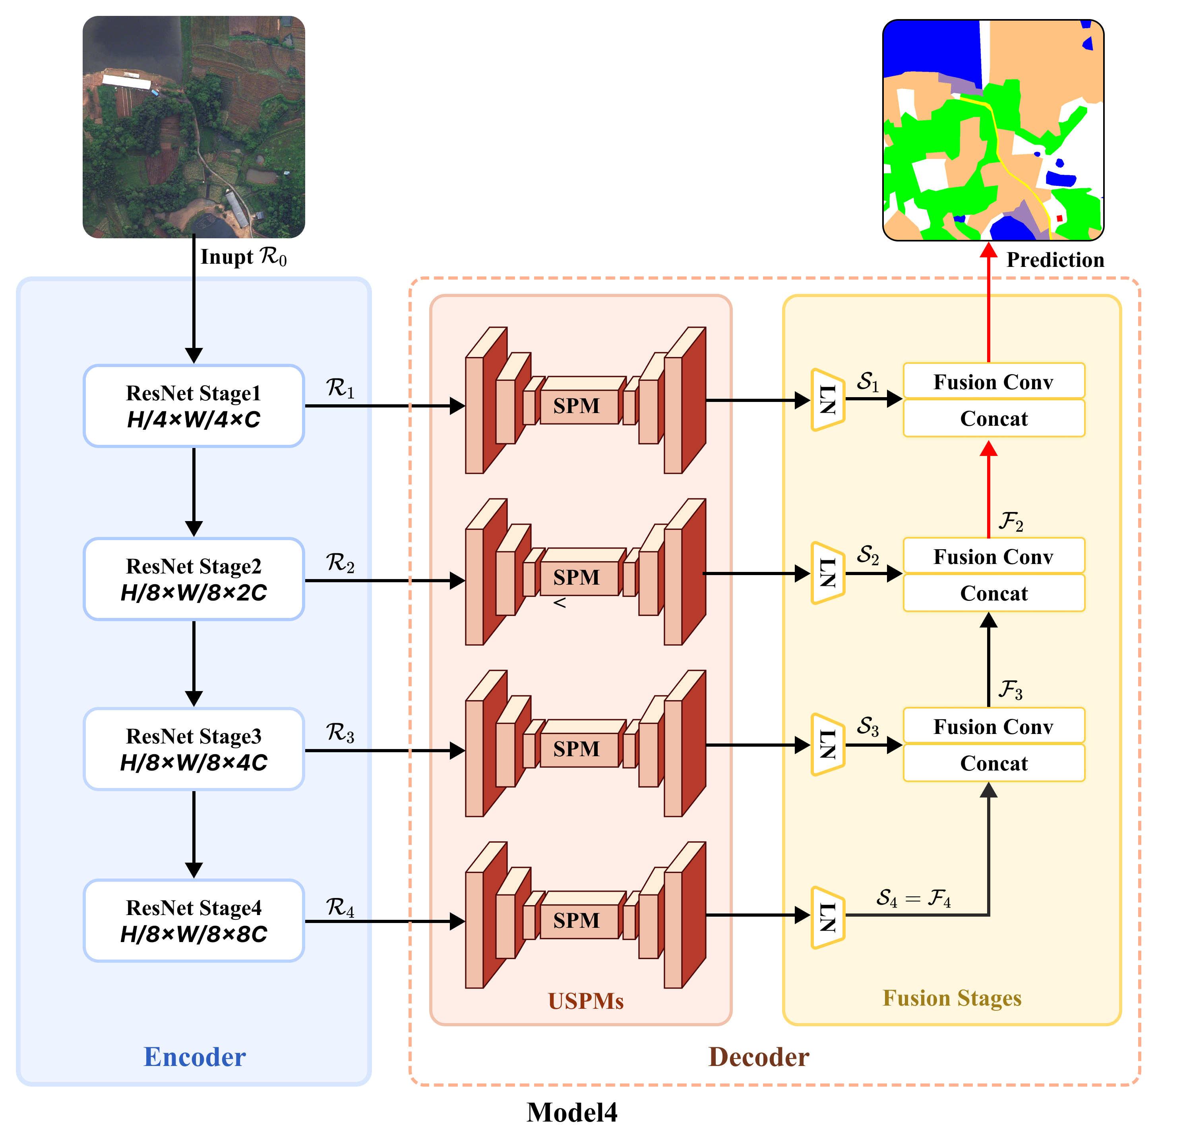
EXPERIMENT
Ablation study
Notes:
To investigate the contributions of each part in our MAPMaN, we conduct the ablation study on LoveDA and Potsdam datasets. We started with Model 1, which removed all UAPM modules. Then, we sequentially added the components of our MAPMaN to this model. Among them, Model 4 is our MAPMaN without channel modulation. This experiment demonstrated the effectiveness of each part in our MAPMaN.

Slide 19
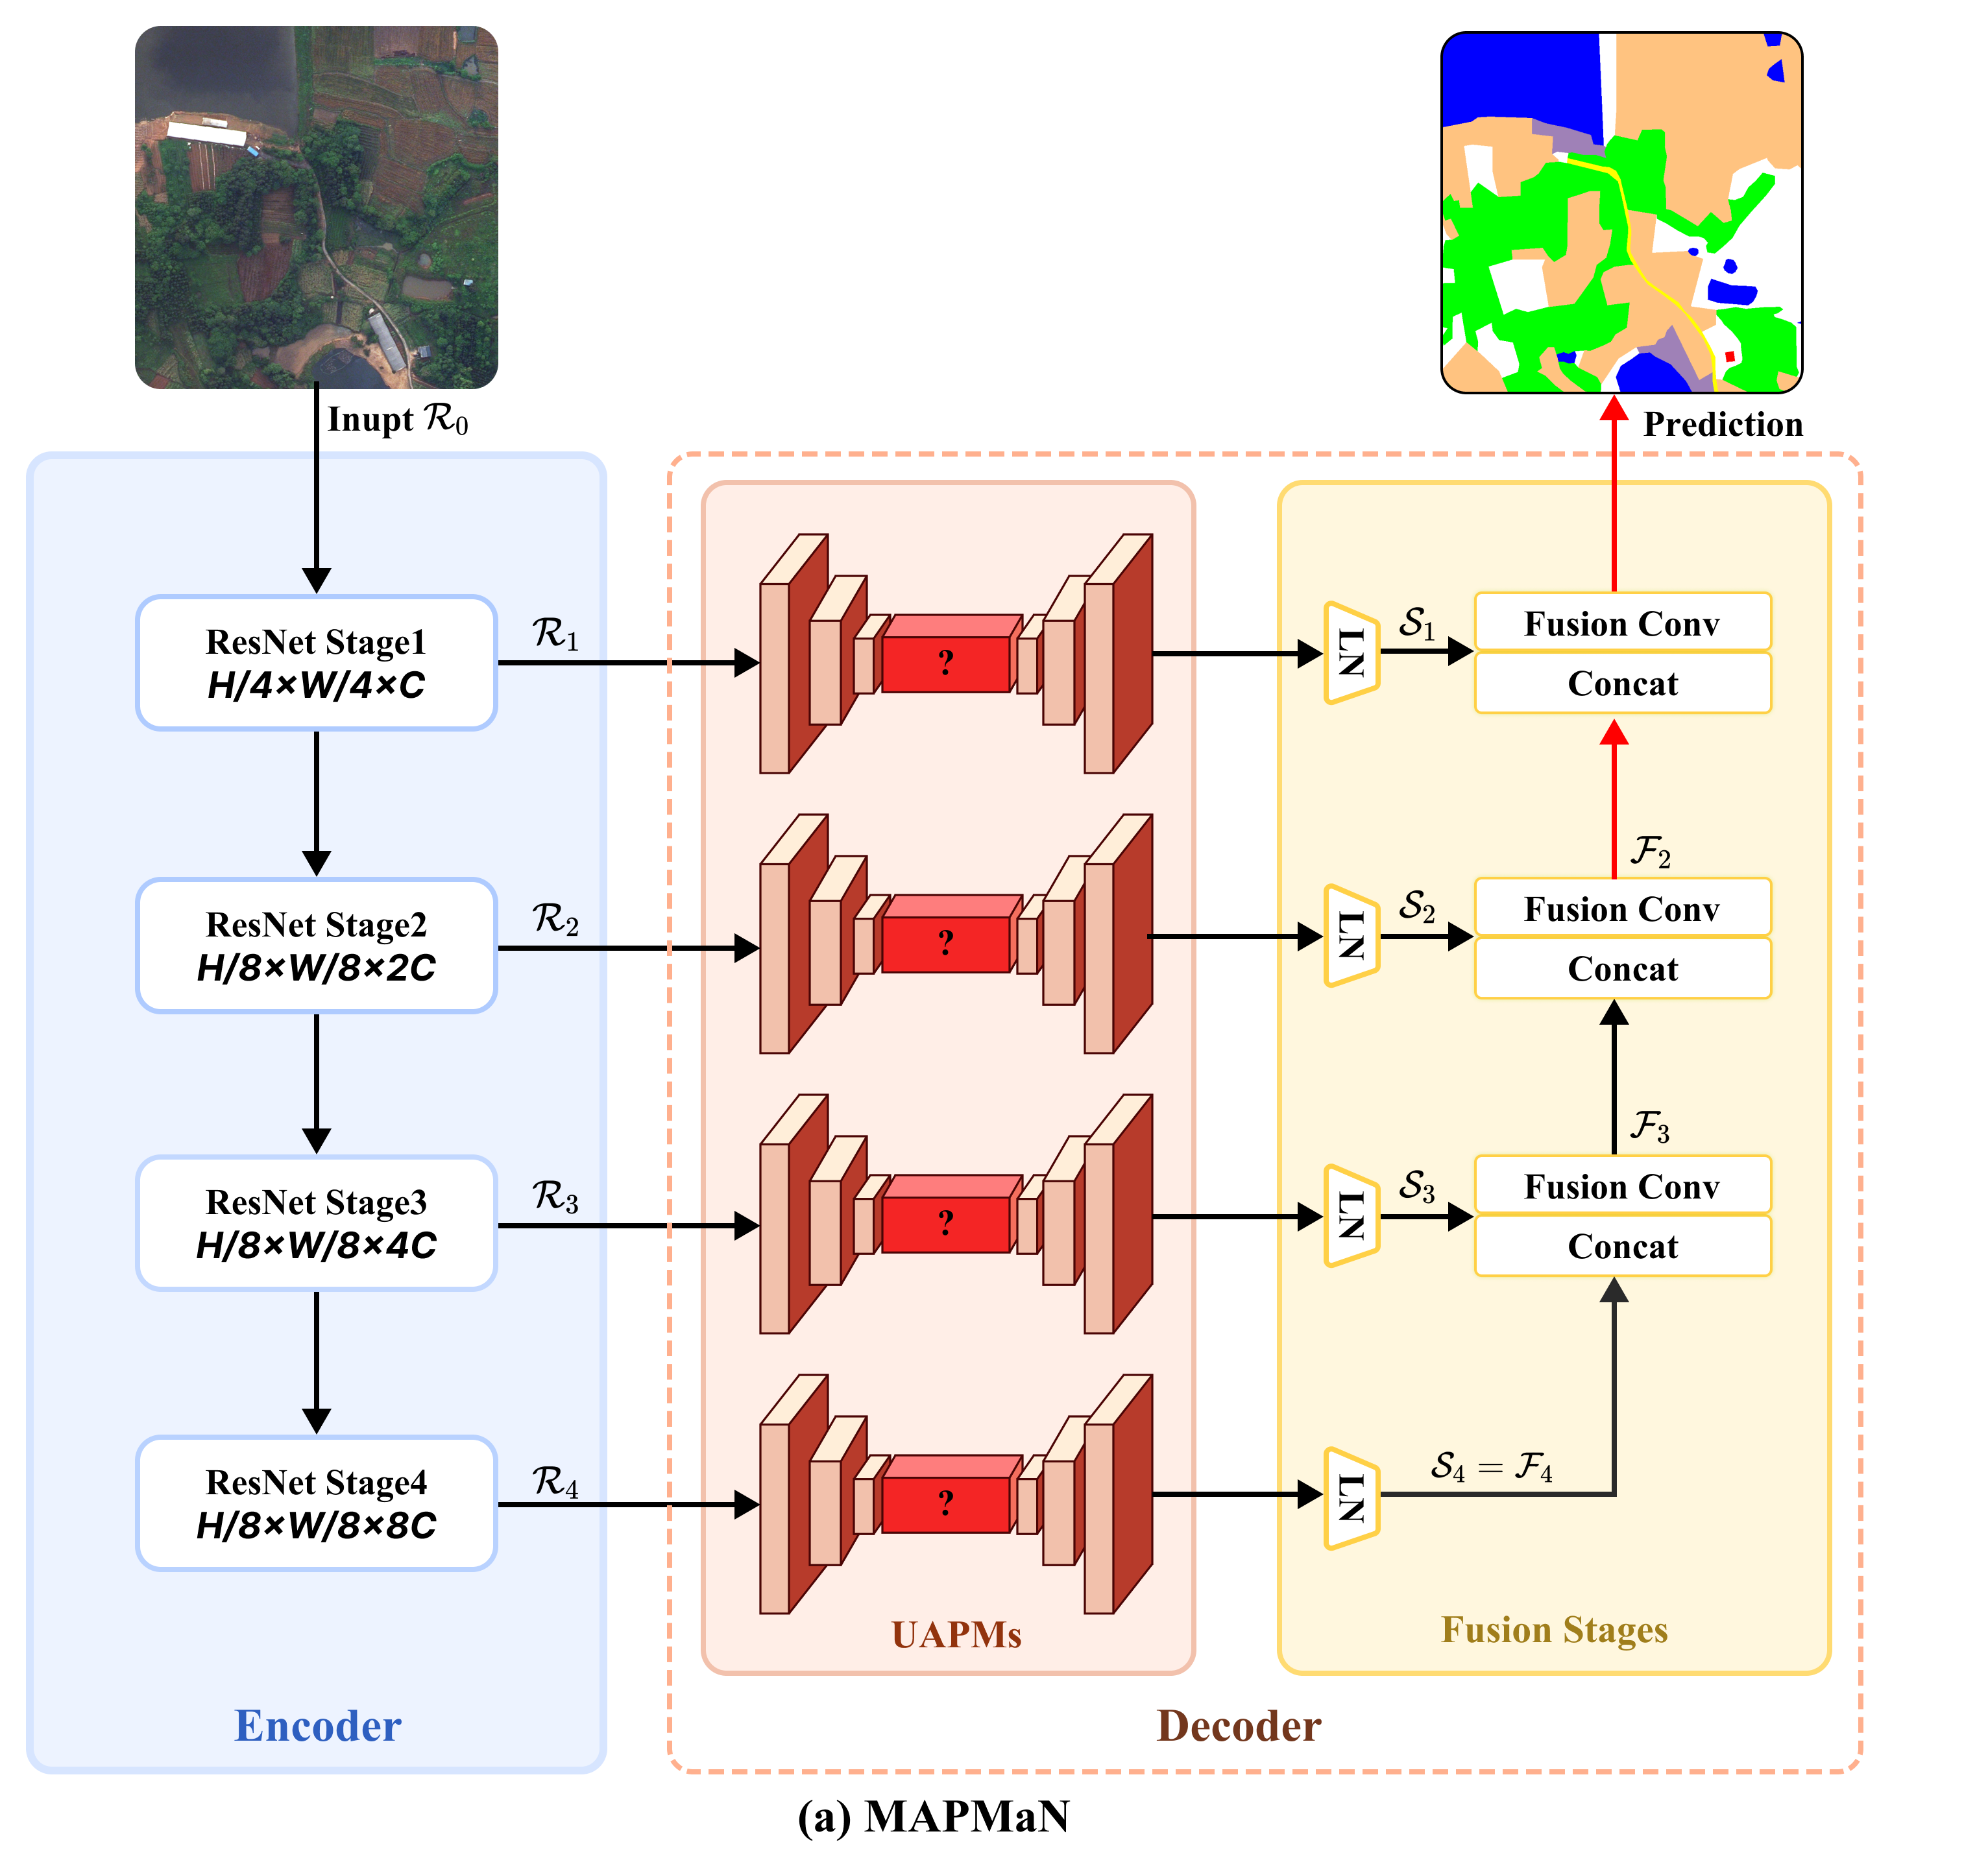
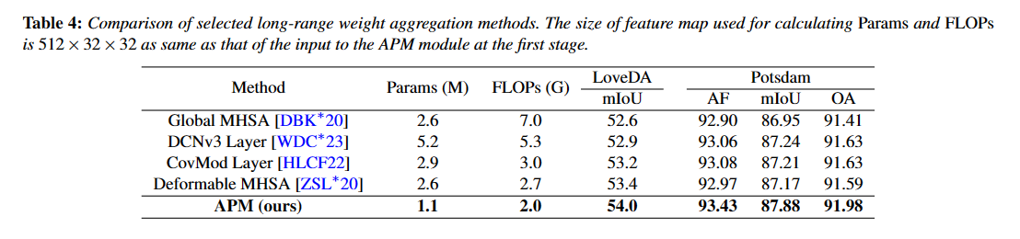
EXPERIMENTS
Ablation studies
Notes:
Additionally, we compare several weight aggregation methods with long-range modeling on LoveDA and Potsdam datasets. Specifically, we replace the APM modules in our MAPMaN with these methods, while the other parts remained unchanged. Global and deformable MHSA modules are all 8-head. The DCNv3 and CovMod blocks are the basic ones in DCNV3 and conv2former. Experimental results show that using APM for weight aggregation in our MAPMaN achieves the best performance with the least computational cost. We interpret this finding as follows: First, indiscriminate feature aggregation with either Global MHSA or CovMod introduces the background noise; second, the DCNv3 block neglects the compositional relationships; third, the attention mechanism compresses the dependence along the channel dimension when calculating the similarity map and lacks overall context understanding, which may lead to inconsistent segmentation within large ground objects and performance degradation of the deformable MHSA.

Slide 20
CONCLUSIONS
Designing a novel long-range adaptive weight aggregation method to recognize spatial distribution patterns in RSIs.
Presenting a nested multi-scale architecture that embeds a tiny U-shaped network after each stage of the backbone.
Proposing the MAPMaN, suggesting the superiority to other state-of-the-art methods on three datasets.
Notes:
TO conclude. Firstly, we design a novel long-range adaptive weight aggregation method to recognize spatial distribution patterns in RSIs.
Secondly, we presenting a nested multi-scale architecture that embeds a tiny U-shaped network after each stage of the backbone. Thirdly,
We propose the MAPMaN, suggesting the superiority to other state-of-the-art methods on three datasets.

Slide 21
Thanks For Your Attention.
Notes:
That’s all, thank for your attention.

